Slide 1


Hackathon Approach & Timeline Overview
Draft 1/19/19

Slide 2
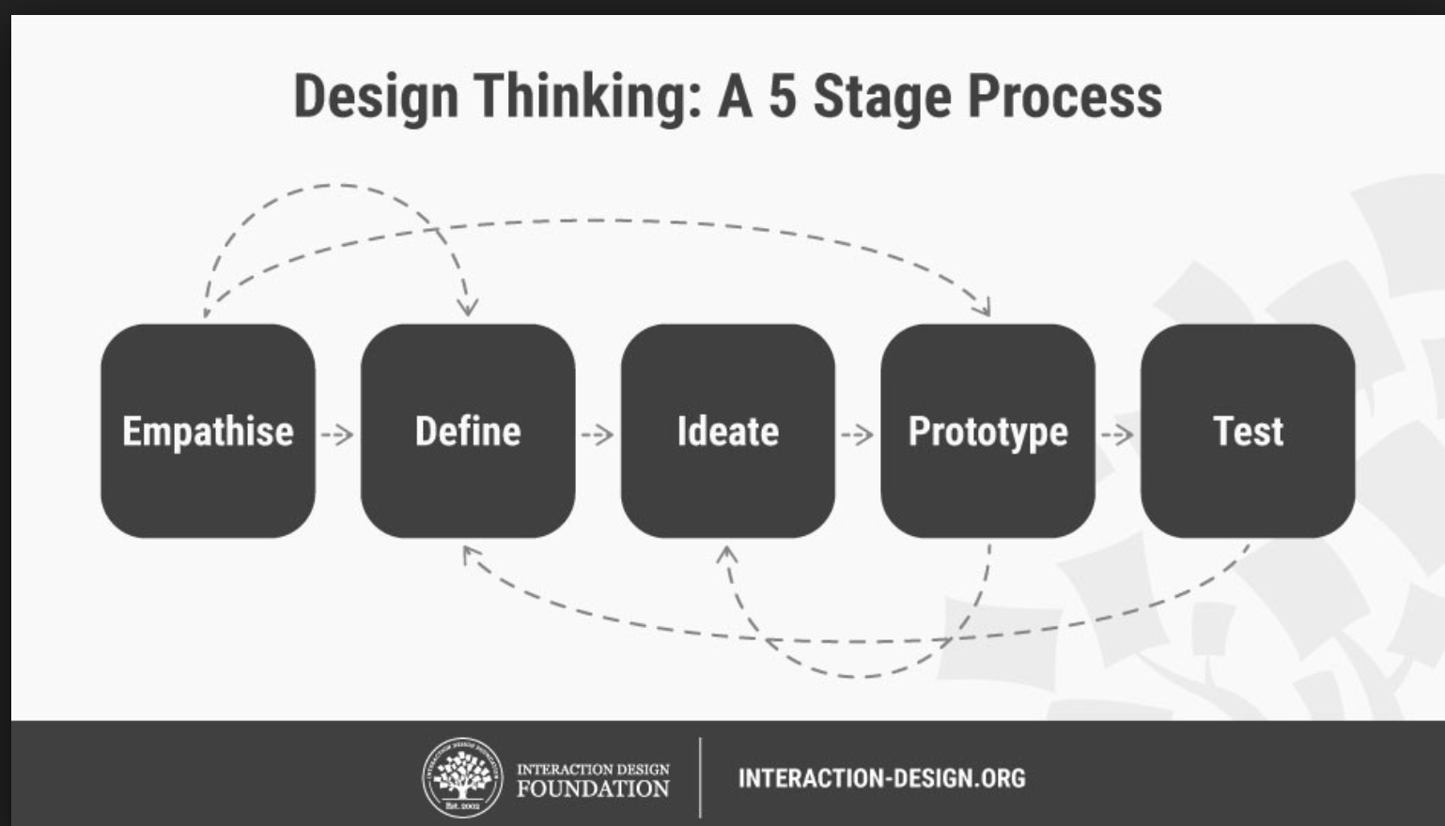
Accelerated Approach Based on Design Thinking

Slide 3
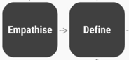
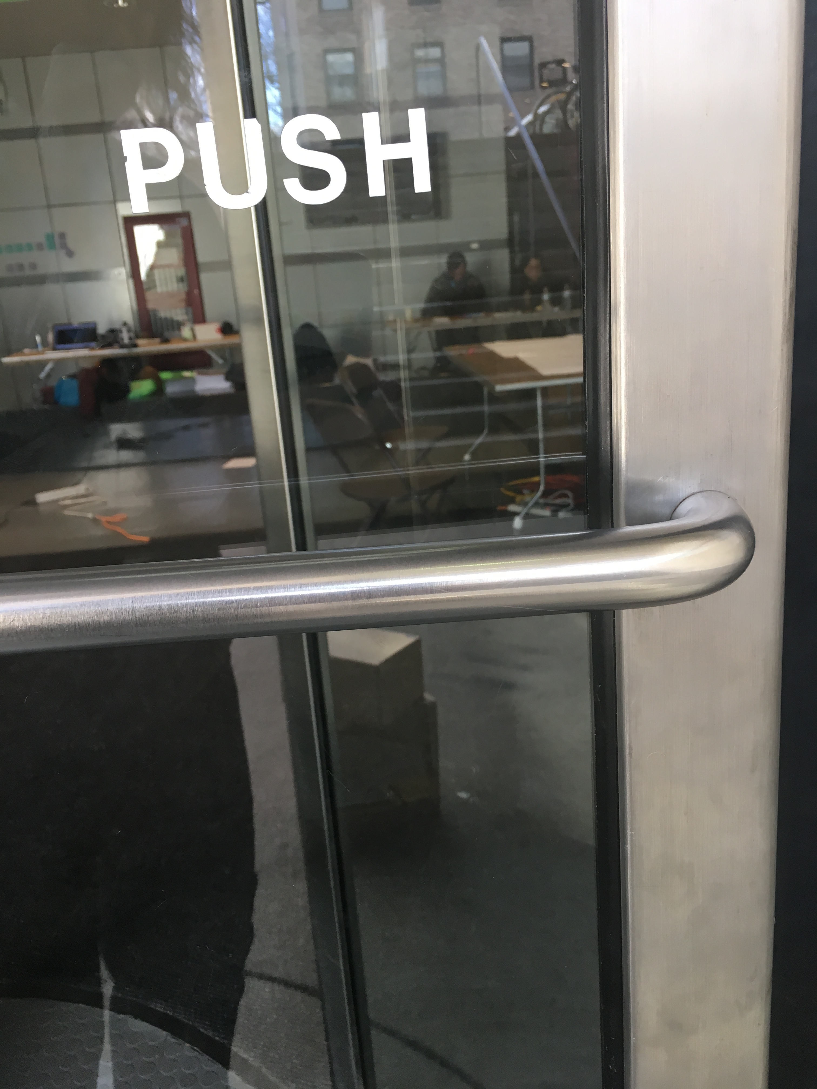
DAY 1: Key Activities & Outputs
Pitch Problem/Solution
Recruit Team
Define Goals:
X-able:
Push the boundaries beyond what’s possible
To shine a spotlight on the rapidly expanding digital divide that is excluding people with permanent and temporary disabilities. People of all ages with visual, phyiscal, hearing and cognitive impairments or conditions are not able to fully experience XR -which excludes them from social, entertainment, education and career opportunities.
Create v1 of an open-source toolkit that extends ADA 508 guidelines and enables developers to anticipate and incorporate accessibility features and functionality into current and future XR experiences.
Demonstrate the use of cross-platform compliant code, supporting for accessibility can transform XR experiences -across platforms and devices- for millions of users worldwide.

Slide 4


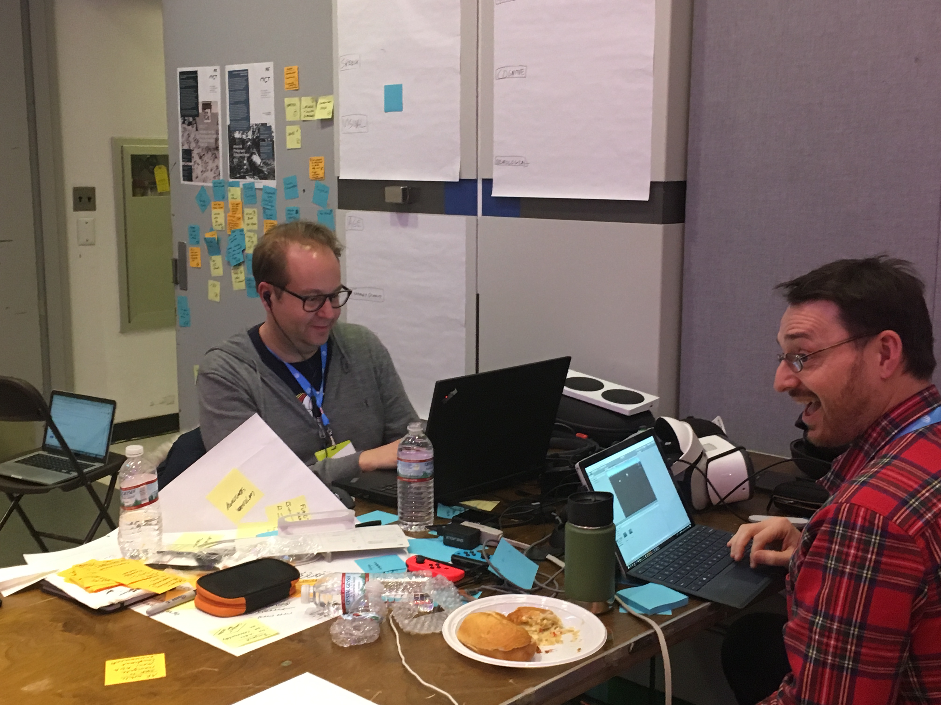
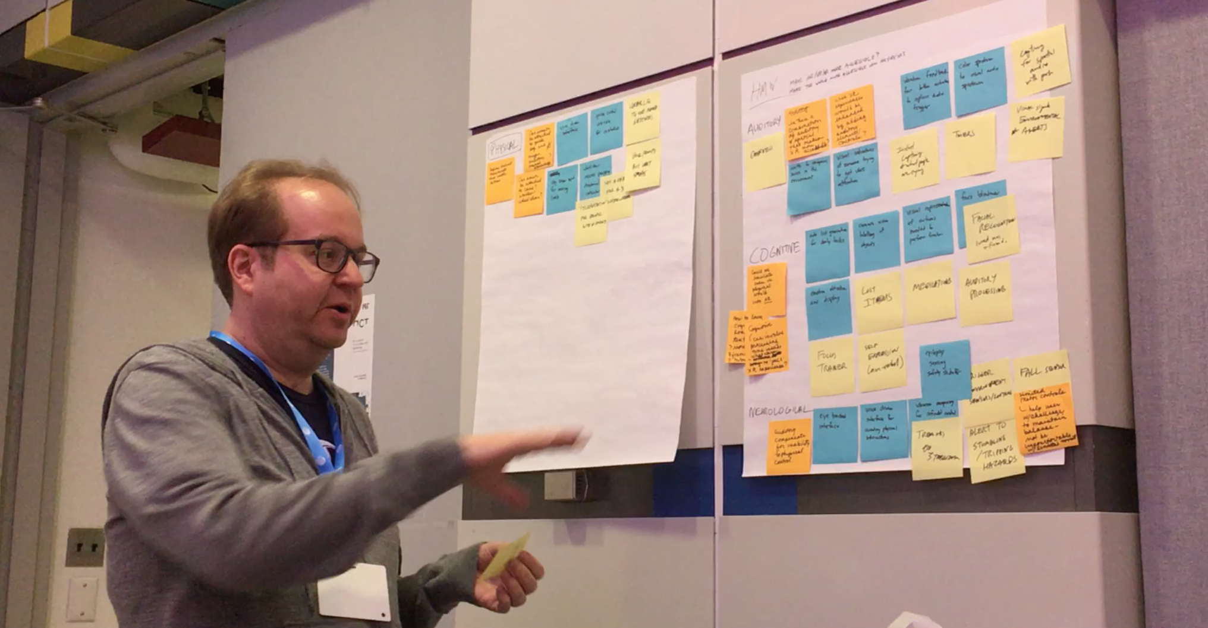
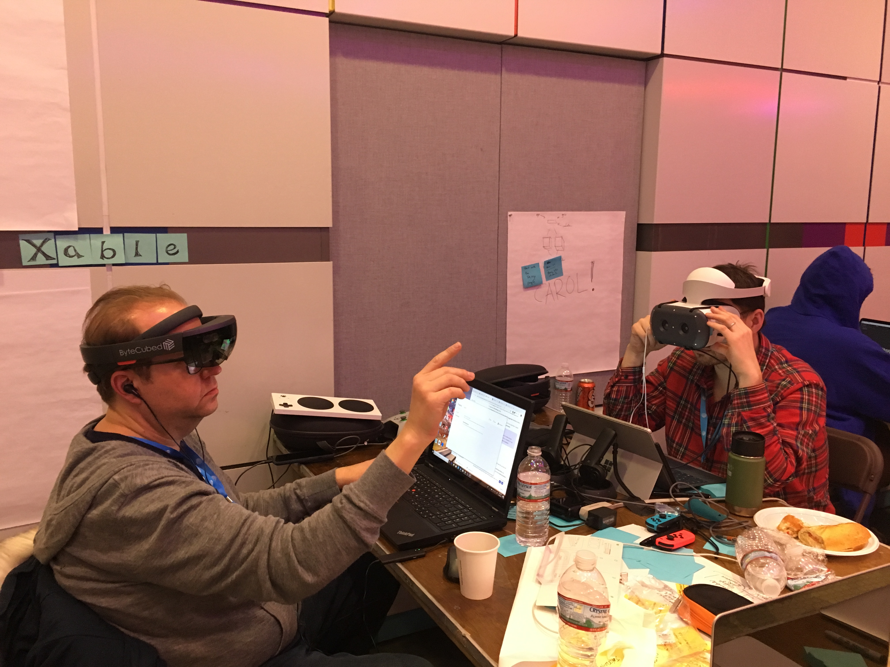
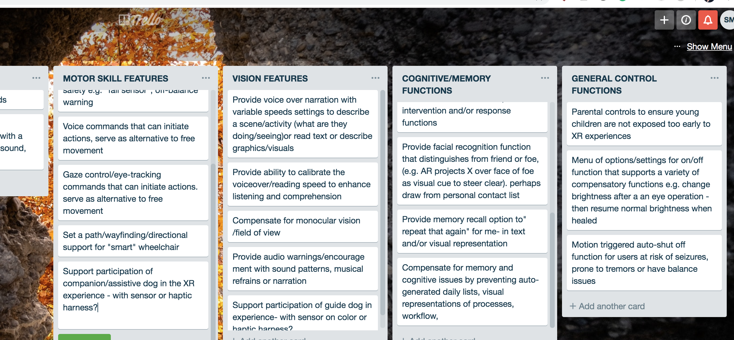
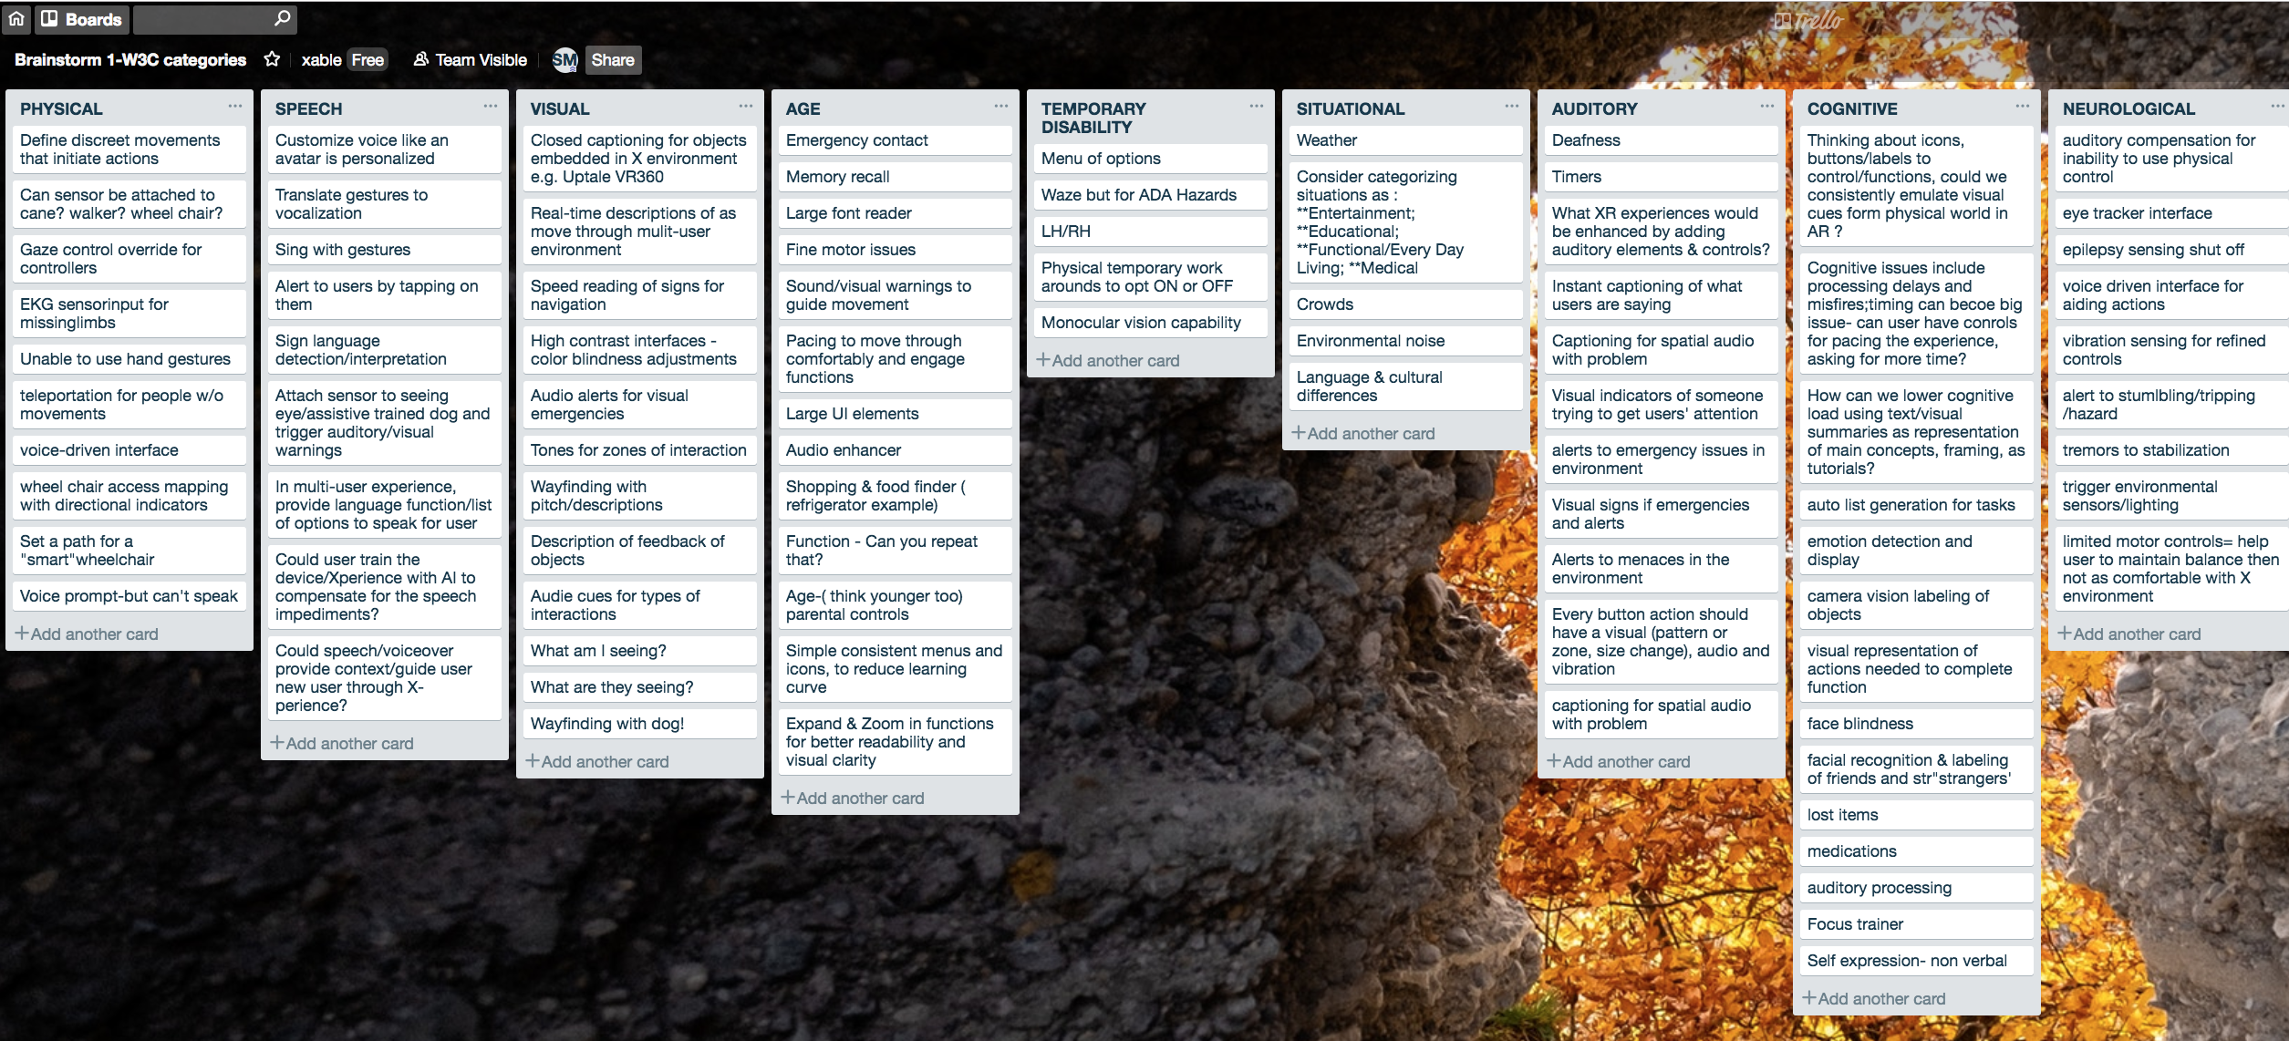
DAY 2: Key Activities & Outputs
Brainstorm needs and opportunities
Research features/functionality gaps and impacts
Experiment across platforms & devices
Insert pic: Mike & son

Slide 5

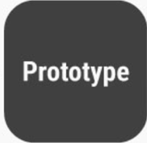
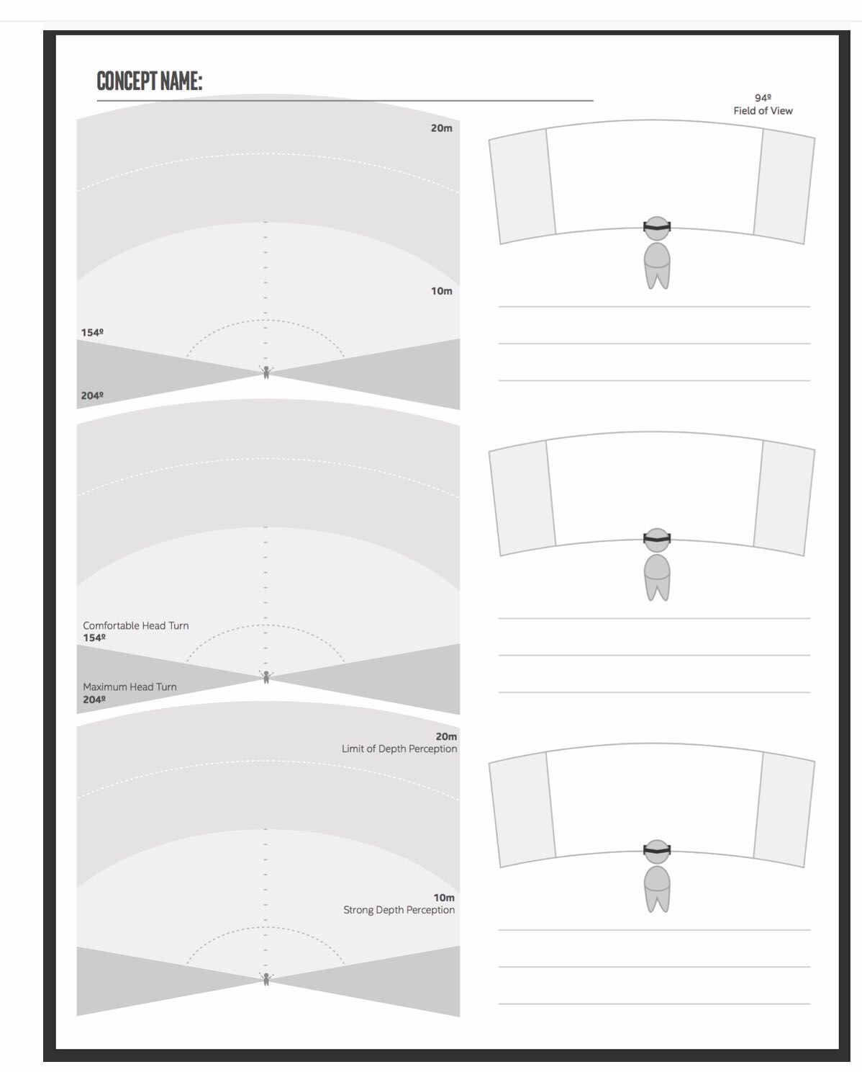
DAY 3: Key Activities & Outputs
Define/iterate scenarios
Begin prototyping
Conduct testing
Continue documenting

Slide 6
DAY 4: Key Activities & Outputs
Iterate and test
Document and share
Prep and deliver

